Slide 1
70-533 : Implementing Microsoft Azure Infrastructure Solutions

Slide 2
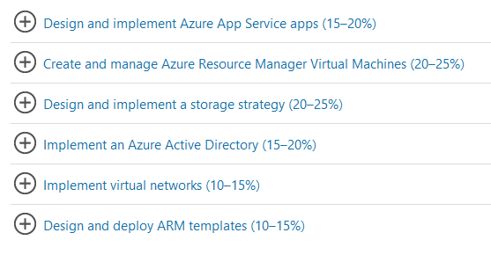
70-533 : Implementing Microsoft Azure Infrastructure Solutions

Slide 3
Configure Cloud Services

Slide 4
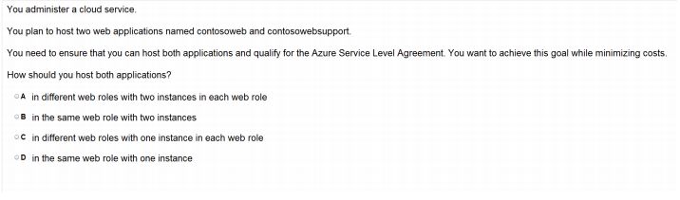

Slide 5
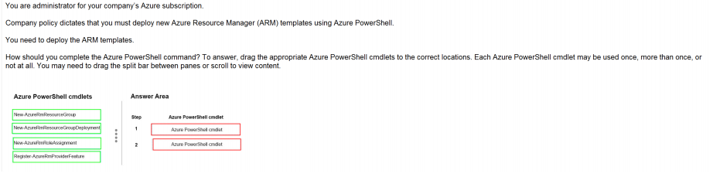
Ans =

Slide 6
Description
The New-AzureRmResourceGroup cmdlet creates an Azure resource group. You can create a resource group by using just a name and location, and then use the New-AzureRmResource cmdlet to create resources to add to the resource group. To add a deployment to an existing resource group, use the New-AzureRmResourceGroupDeployment cmdlet.
To add a resource to an existing resource group, use the New-AzureRmResource cmdlet. An Azure resource is a user-managed Azure entity, such as a database server, database, or website. An Azure resource group is a collection of Azure resources that are deployed as a unit.

Slide 7
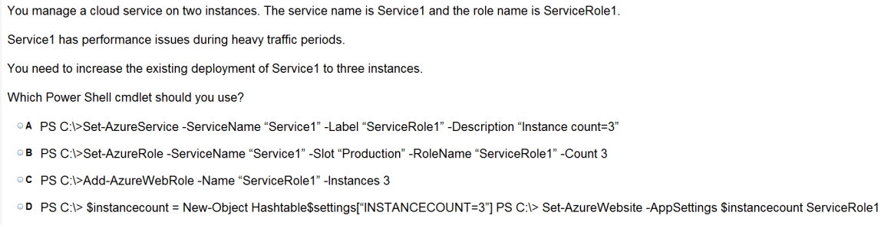

Slide 8
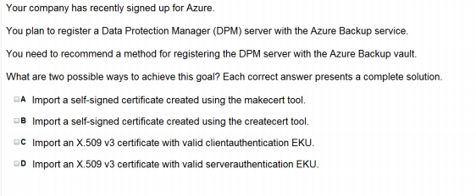

Slide 9
Deploy and manage Cloud Services

Slide 10
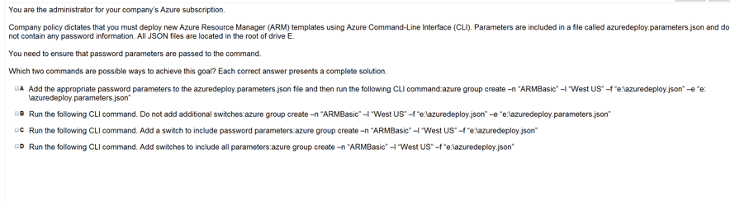

Slide 11
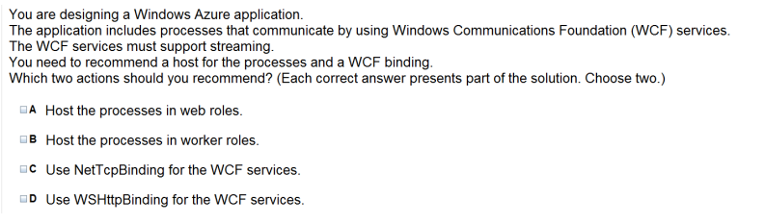

Slide 12
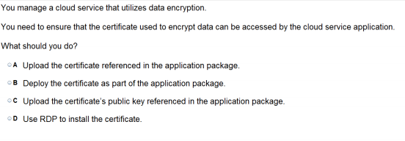

Slide 13
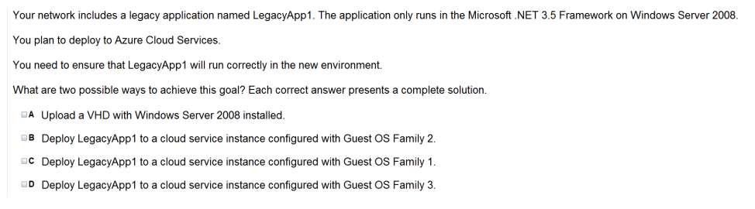

Slide 14
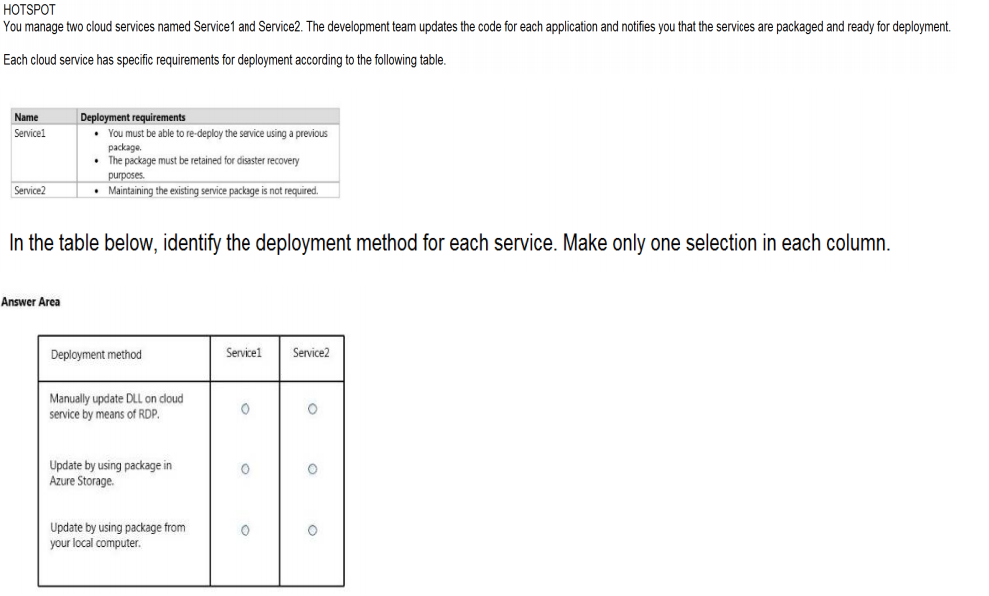
Ans =

Slide 15
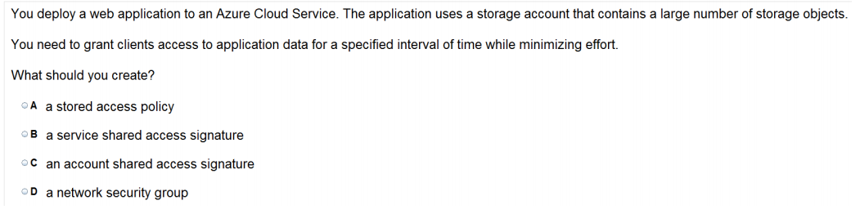

Slide 16
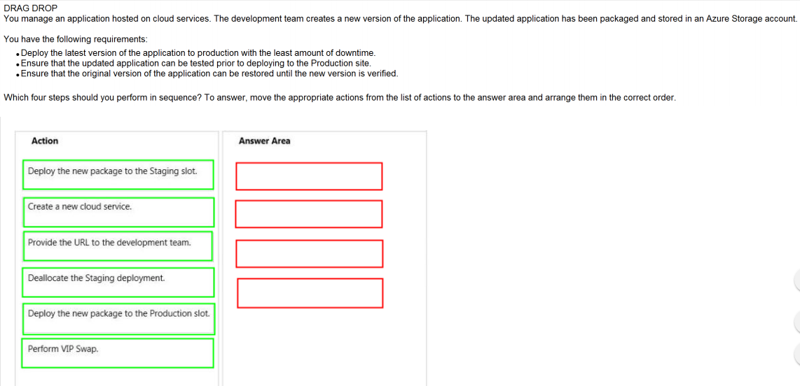
Ans =

Slide 17
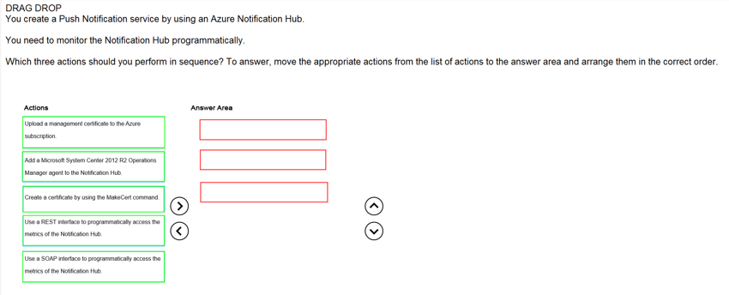
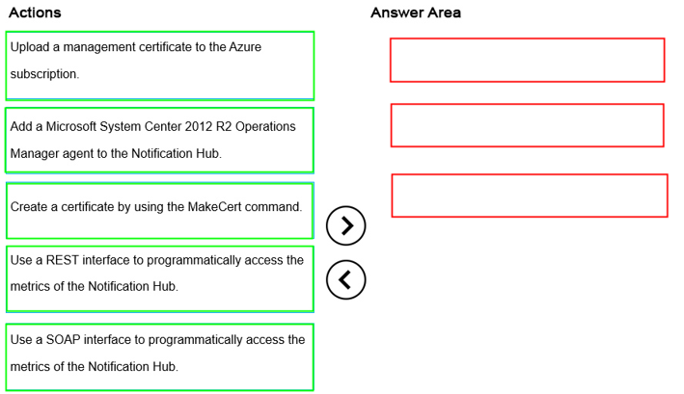
Ans =

Slide 18
Monitor Cloud Service

Slide 19
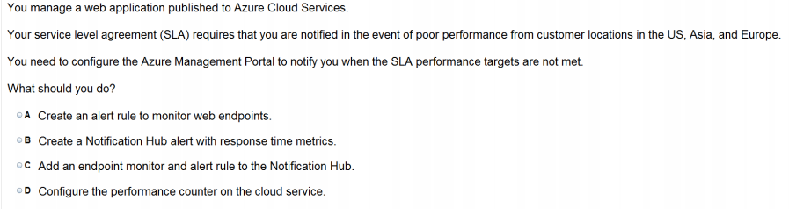

Slide 20
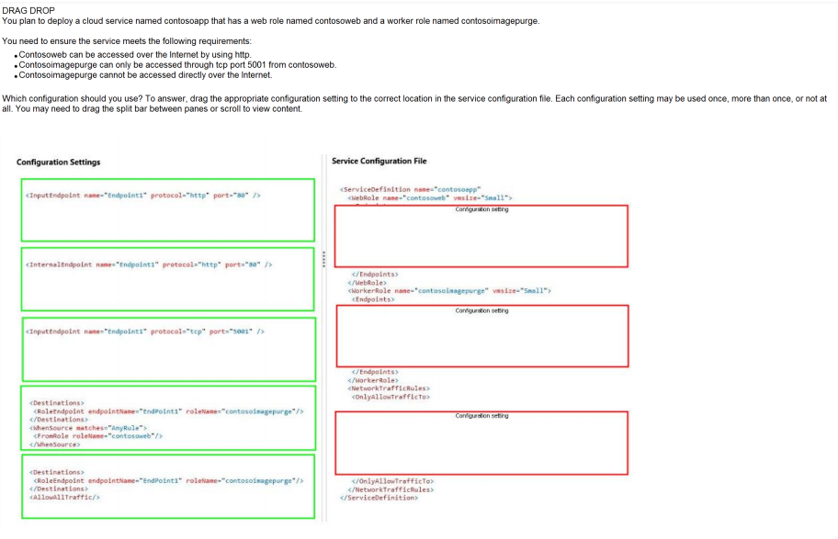
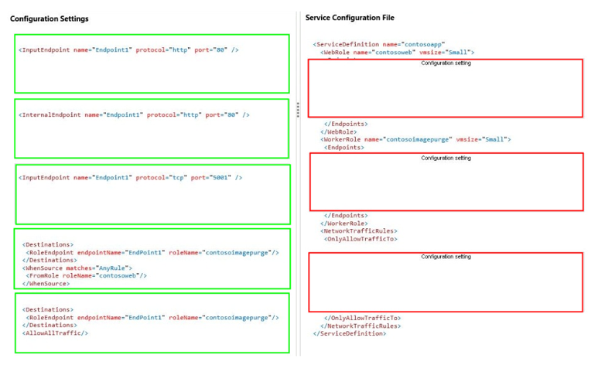
Ans =

Slide 21
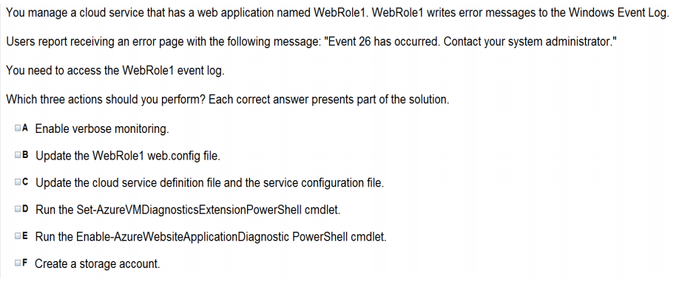

Slide 22
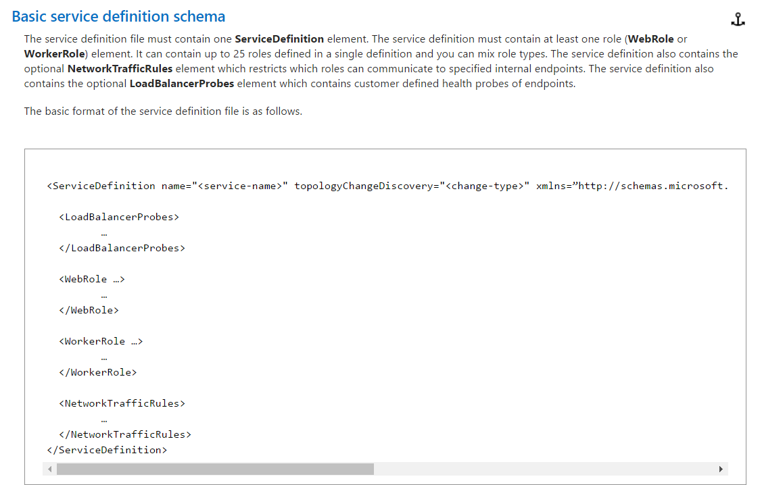
The service definition file defines the service model for an application. The file contains the definitions for the roles that are available to a cloud service, specifies the service endpoints, and establishes configuration settings for the service.

Slide 23
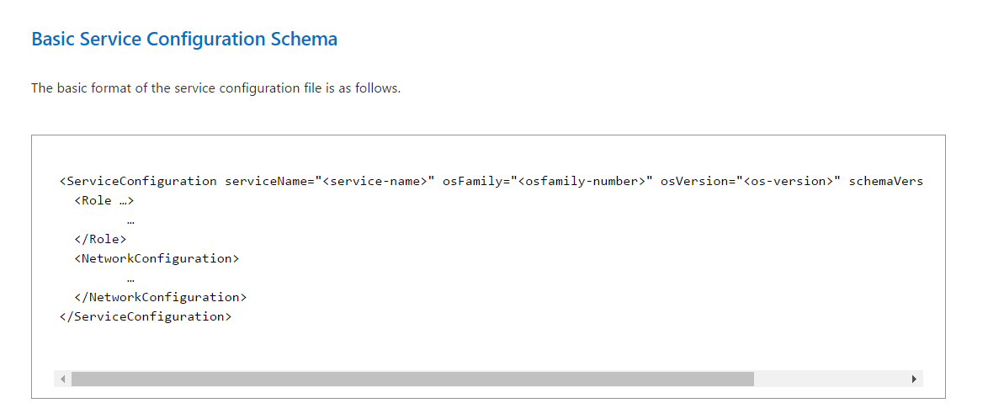
The service configuration file specifies the number of role instances to deploy for each role in the service, the values of any configuration settings, and the thumbprints for any certificates associated with a role. If the service is part of a Virtual Network, configuration information for the network must be provided in the service configuration file, as well as in the virtual networking configuration file.

Slide 24
Azure Service Bus

Slide 25
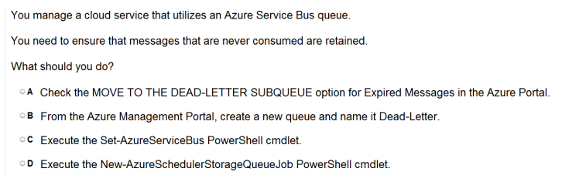

Slide 26
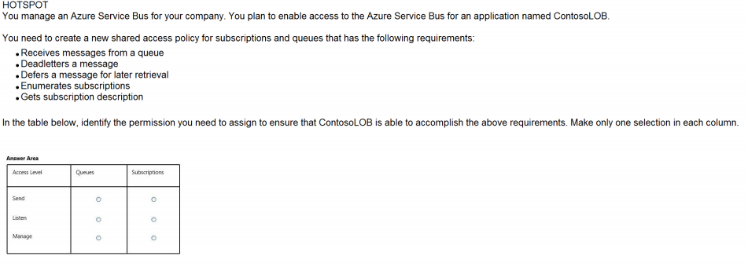

Slide 27
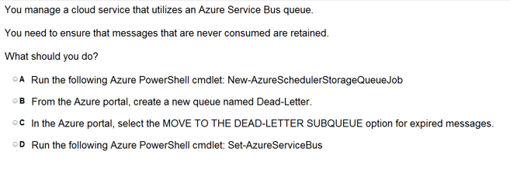

Slide 28
Azure Back up

Slide 29
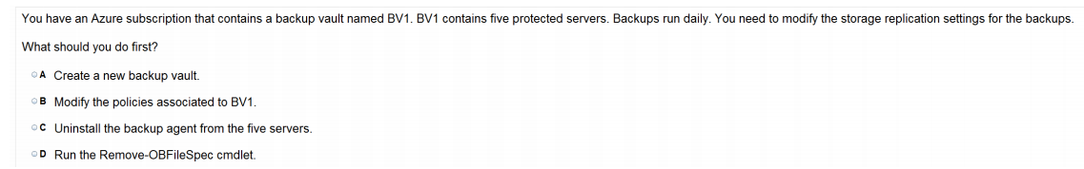

Slide 30
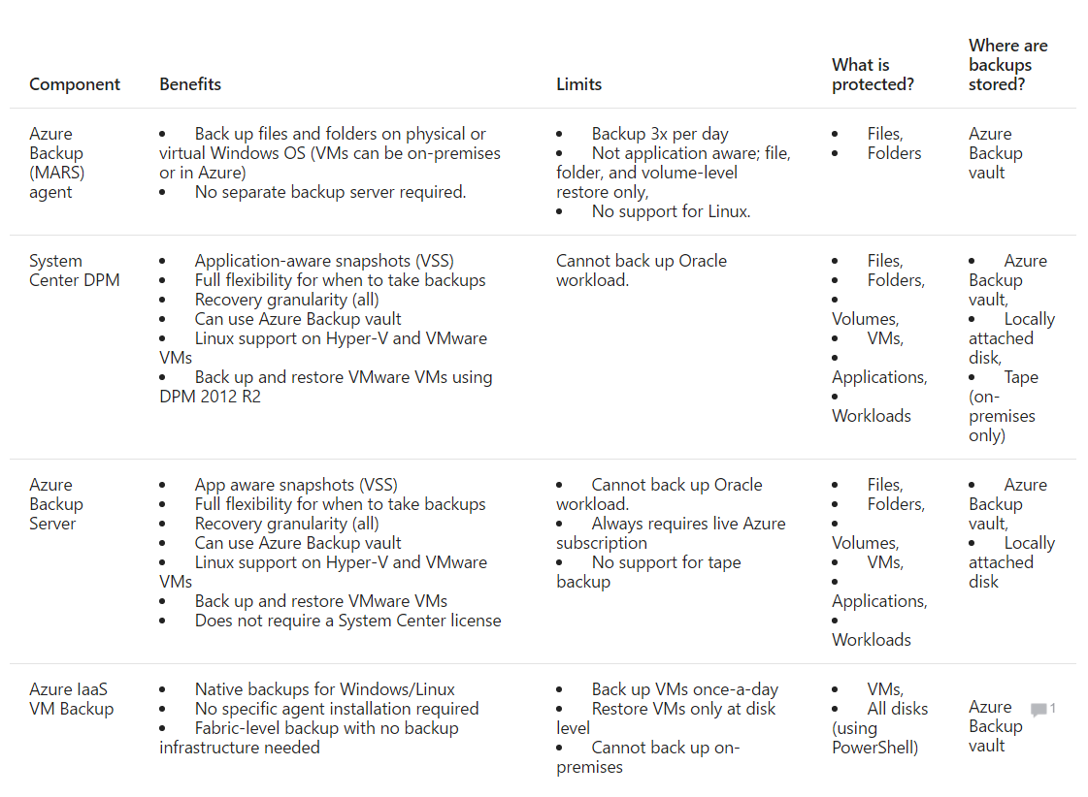

Slide 31
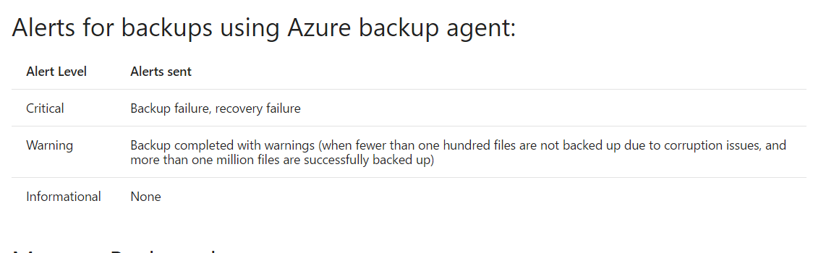

Slide 32
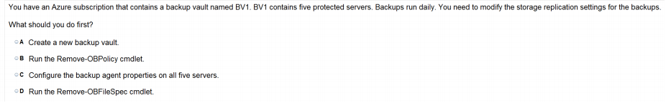

Slide 33
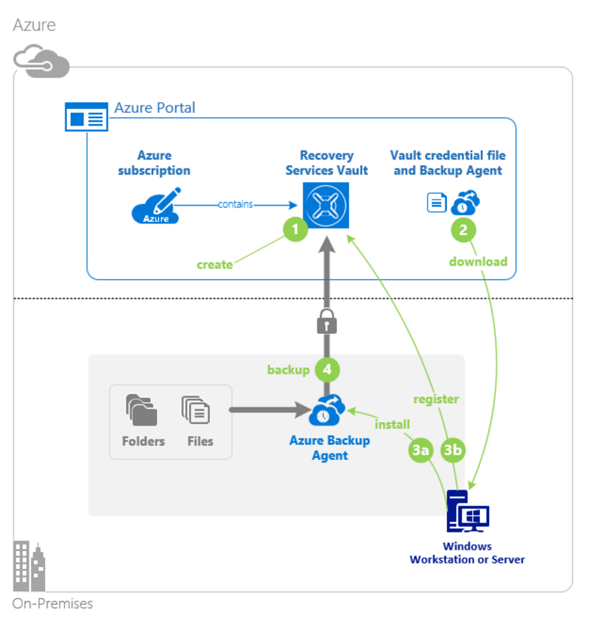
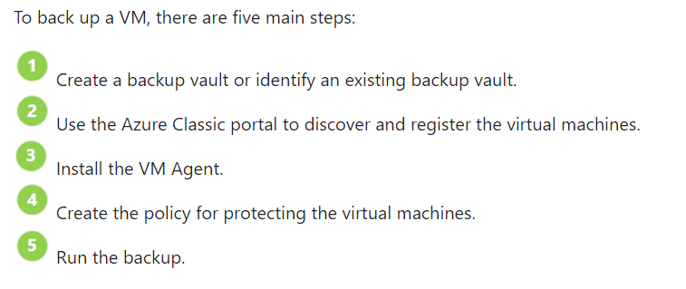

Slide 34
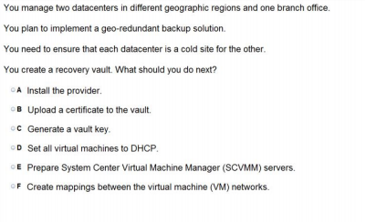

Slide 35
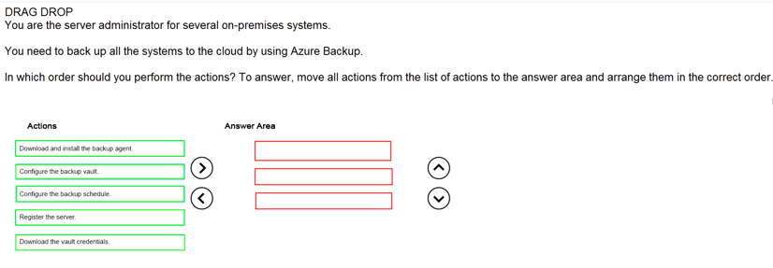
Ans =

